Slide 1
CABGOC
Non Conformance Report
- Procedure Overview -
Operational Discipline Group

Slide 2
Purpose and objective
The purpose of the nonconformance management process is to ensure that required proactive inspections, tests and preventative maintenance tasks are completed per plan and discovered asset integrity deficiencies are properly reviewed and addressed with risk mitigation and corrective action plans in order to maintain the safe operation of SASBU facilities

Slide 3
Asset Integrity Management Nonconformance
A Nonconformance includes both overdue integrity critical tasks as well as discrepant material conditions on integrity critical assets
  Integrity Critical Tasks Examples
    Piping, Vessel, Structure (Fixed Equipment) Inspections
    PSV Testing
    SDV, BDV, SSSV, F&G, and other Compliance Testing
  Discrepant Material Conditions Examples
    Piping, Vessel, Structure found to not satisfy acceptance criteria (below minimum allowable thickness for pressure or structural integrity)
    Safety Valves or systems found to not function per design standards
      BDV not blowing down a compressor in specified time
      PSV that does not lift at set pressure
      SDV that does not fully close
      UPS that is out of service

Slide 4
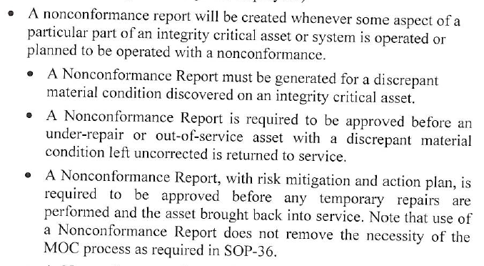
SASBU Requirements for NCR
Notes:
AIM Procedure
Communication Objective:
Refer to notes on same slide highlighting Section 5
This section will give an overview of section 8.0 – Execute, plan, and track compliance

Slide 5
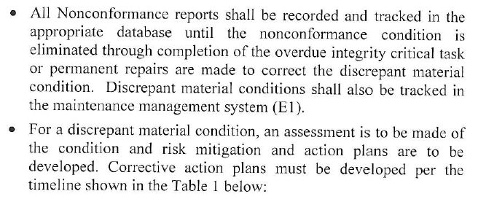
SASBU Requirements for NCR

Slide 6
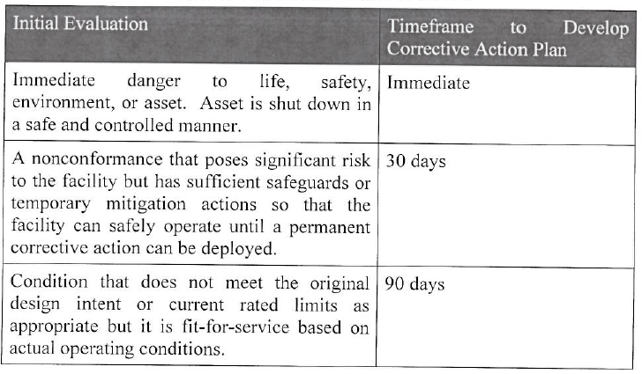
Corrective Action Timeline

Slide 7
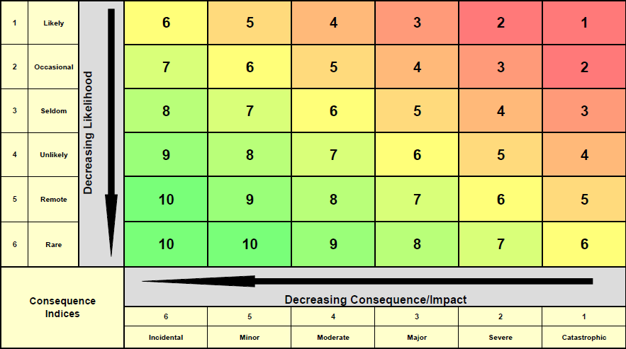
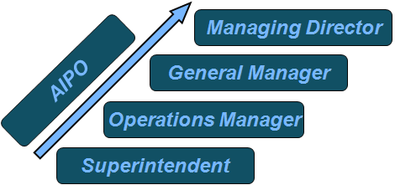
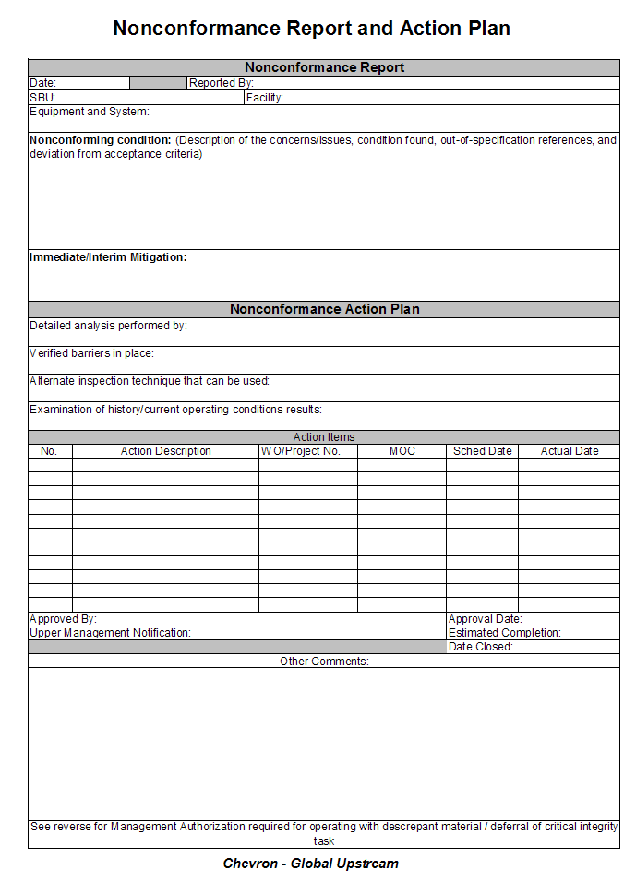
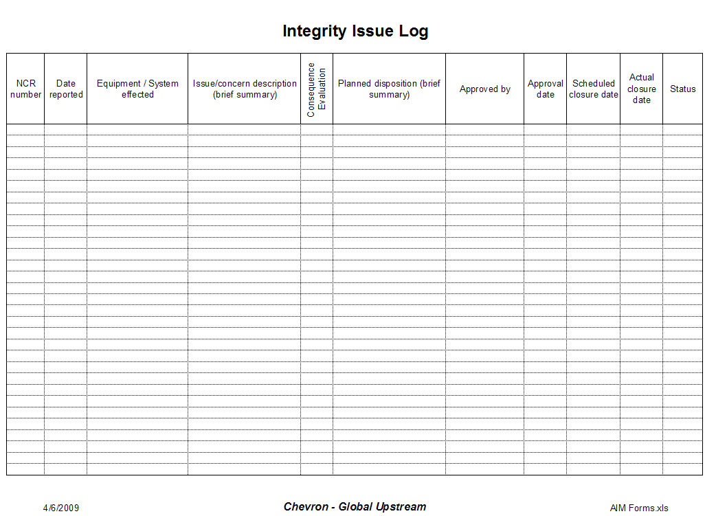
Review of Nonconformance Process
Discrepant Material Condition discovered
Evaluate Severity
NCR Initiation
Technical Analysis
Risk Analysis
Recom-mendation
Approval
Tracking
Task Deferral
Notes:
Nonconformance process
Communication Objectives:
There is a process which needs to be followed for each type.
Discrepant Material
Evaluated for severity (Shutdown vs 30 days vs 90 days).
Seek approval
Overdue tasks
Nonconformance needs to be approved before task due date.
NCR process is however the same for both types
Initiation / TA / RA / Recommendation / Approval / Tracking

Slide 8
Nonconformance Initiation
Review of Nonconformance Process
NCR Initiation
Technical Analysis
Risk Analysis
Recommendation
Approvals
Tracking
  Nonconformance process is initiated when IC1 or IC2 equipment is operated, or planned to be operated, with a nonconforming condition (deviation)= discrepant material or over due task.
  Discrepant Material Condition
    Deviation from recognized standards or specification and affects the ability of the asset to perform its critical functions
    Material deviations are typically identified through inspection and maintenance activities
    In-service nonconformance found during operations, requires initial fitness-for-service assessment to be performed immediately and corrective action plans to be developed in a timely manner
Notes:
Discrepant Material
Communication Objectives:
Discrepant Material Conditions Examples:
Wall thickness less that design
Coating damage
Incorrect valve trim utilized
Temporary Leak Repairs

Slide 9
Review of Nonconformance Process
Technical Analysis
NCR Initiation
Technical Analysis
Risk Analysis
Recommendation
Approvals
Tracking
  All NCRs are accompanied by a technical analysis:
  Technical analysis should address:
    Description of the compromised barrier
    Analysis of the system including existing safety barriers
    Evaluation of operating history and current operating conditions
    Technical recommendation including analysis of temporary and/or permanent solution
    Technical evaluation of likelihood of equipment failure
Notes:
Technical Analysis
Communication Objectives:
Go through list which communicates what is expected for a good technical analysis.

Slide 10
Review of Nonconformance Process
Risk Evaluation of Recommended Mitigation or Solution
NCR Initiation
Technical Analysis
Risk Analysis
Recommendation
Approvals
Tracking
  A risk analysis is performed as part of the evaluation of the nonconformance. The risk analysis should consider the following:
    An analysis of the incremental change in risk as a result of the nonconformance.
      Note: The original failure consequences will remain the same unless the inherent hazards within the system have changed.
    Likelihood of failure for temporary or permanent solution will be provided by the technical analysis which needs to account for:
      Evaluation of operating history and current operating conditions
    Analysis of the layers of protection available and an evaluation of status or adequacy
Notes:
Risk Evaluation of selected alternative
Communication Objectives:
The recommendation then needs to be re-risked using the Chevron Integrated Risk Prioritization Matrix. It is important to communicate the change in risk to the approver of the NCR. Risk should also include the safeguards provided by other layers of protection.

Slide 11
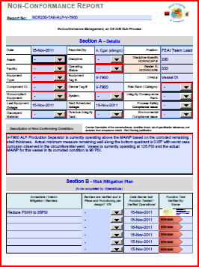
Review of Nonconformance Process
NCR Package
NCR Initiation
Technical Analysis
Risk Analysis
Recommendation
Approvals
Tracking
  NCR package includes:
    Description of compromised barrier
    Recommended actions and close out dates
    Supporting documents including
      Technical analysis of situation and proposed solution (including reviewed alternatives)
      Revised risk analysis for equipment failure
Notes:
Overdue task NCR
Communication Objectives:
Team to prepare the NCR package which should include the information provided in the slide.

Slide 12
Review of Nonconformance Process
NCR Approval Process
NCR Initiation
Technical Analysis
Risk Analysis
Recommendation
Approvals
Tracking
  Approve nonconformance using the management authorization process.
    Nonconformance report will be escalated in accordance with the Management Authorization Procedure. Approval level will be dependent on the nature and potential consequence of the equipment involved. Abbreviated authorization tables are shown below.
Discrepant Material
Nonconformance Approval
Overdue Tasks
Notes:
Nonconformance Approval Process
Communication Objectives:
Type and nature of the NCR will affect the required level of approval.
Discrepant Material
Potential consequence dependent determines level on management authorization.
Overdue Tasks
Deferral duration dependent (as a percentage of proposed delay .vs. planned interval).

Slide 13
Review of Nonconformance Process
Monitor Integrity Issue Log
NCR Initiation
Technical Analysis
Risk Analysis
Recommendation
Approvals
Tracking
  Integrity Issue Log (the IIL) is used to track all nonconformances for all disciplines and include:
    Description of nonconformance
    Nonconformance mitigation plan
    Consequence and Risk information
    Actions
    Nonconformance level of approval
    Priority information
Notes:
Integrity Issue Log
Communication Objectives:
All actions to be captured in the integrity critical log. Key information which needs to be included in the log are highlighted in the slide.

Slide 14
IC1 & IC2 Focuses on High Consequences
A NCR is only a management system to report deviations on Integrity Critical Assets
Deviations Managed by existing Maint, Inspection, and PM systems
Devations Managed by Non-conformance Process
Notes:
Scope of the Asset Integrity Program
Communication objective:
The Chevron Integrated Risk Prioritization Matrix is used to identify what is important.
Equipment is incorporated into the AIM program based on assessed consequence considering safety, health, environment, and asset consequences. Other equipment is incorporated into existing inspection, reliability, and ,maintenance programs.
Only failures which can result in a potential Consequence 1 and 2 are included into AIM.
Definition of Consequence 1 and 2 are defined on the next page.

Slide 15
MOC and NCR
  Many NCRs will also require a MOC
    There is a box on the NCR form to put the MOC number
    A MOC documents a change to process feed / chemical alterations, mechanical, electrical, instrumentation, control logic, and design trip limits and include clamps / wraps installations.
  Examples of a NCR that does not require a MOC – no change
    Equipment below minimum thickness that passes Fitness for Service evaluation
    Materials with different specifications same properties (A106 Gr. B vs API 5L)
    Mitigating action plans that do not require a physical change
      Increased UT or RT monitoring

Slide 16
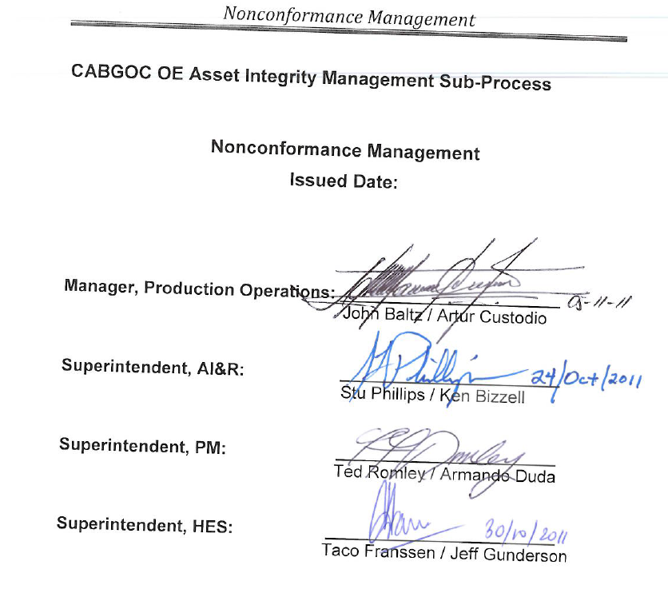
Review of Nonconformance Process
CABGOC NCR Procedure – Issued October
Safe Work Practice
Nonconformance Management
CABINDA GULF OIL COMPANY
Notes:
Superintendent
CABGOC Management process was issued in October
Have copies here if you’d like one

Slide 17
NCR Form & IIL Log
Notes:
Communication Objective:
Bring up link to show the NCR form

Slide 18
Roles & Responsibilities
Role
Responsibility
  All SASBU Employees or Contractors (Operators, Technicians, Inspectors, Analysts, Engineers, Foremen, Supervisors)
    Report any identified nonconformance issue to Asset Owner through the NCR Champion
      Overdue integrity critical task
      Discovered equipment deficiency
    Serve on or lead nonconformance review teams as designated by Asset Owner
Notes:
Communication Objectives: Cover Overall Process Roles as well as Nonconformance Process Roles
See information in Slide

Slide 19
Roles & Responsibilities
Role
Responsibility
  Area Superintendent
    Assemble a subject matter expert team with team leader (Area NCR Champion) to develop NCRs and track NCAPs
    Review and approve all reports and Ops Manager notification
    Route approved NCRs to the Ops Manager
    Ensure mitigation plans are executed before returning equipment to service
    Ensure E1 work requests are issued for temporary and permanent repairs
    In the future process will require higher levels of approvals
Notes:
Superintendent
Communication Objectives: Cover Overall Process Roles as well as Nonconformance Process Roles
Most important is assigning the NCR champion for the area

Slide 20
Roles & Responsibilities
Role
Responsibility
  Area NCR Team Leader (NCR Champion)
    Assemble a team of subject matter experts to complete NCRs as required by NCR procedure
    Keep superintendant appraised of all actions and close outs for NCRs
    Assign responsibilities for closure of actions items and determine closure dates
    Schedule updates on at least a quarterly basis
    Ensure action and mitigation plans, and MOCs proceed as scheduled in the NCAP
    Ensure E1 work requests are issued for temporary and permanent repairs
Notes:
Superintendent
Communication Objectives: Cover Overall Process Roles as well as Nonconformance Process Roles
Most important is assigning the NCR champion for the area

Slide 21
Roles & Responsibilities
Role
Responsibility
  AI&R NCR Coordinator in PSC (aopsup2)
    Maintains the Master IIL
    Receive and record all Noncompliance Reports
    Ensure proper AI&R Group Code is designated on report and route a copy to the appropriate supervisor.
    Ensure Asset Owner and relevant AI&R Group Supervisor are notified of any overdue action item.
    Assist in the development of monthly and annual Noncompliance Process Status Reports.
Notes:
The AIR Coordinator
Communication Objectives: Cover Overall Process Roles as well as Nonconformance Process Roles
See information in Slide

Slide 22
Roles & Responsibilities
Role
Responsibility
  Nonconformance Management Process Champion
(Asset Integrity & Reliability
Superintendent)
    Serve as SASBU wide advocate of the process to ensure that it is understood and used as designed within the SBU.
    Advise SBU management on any exceptions requested to this process.
    Ensure that annual review of the effectiveness of the process is performed. This should include available metrics and audit findings.
Notes:
AIR Superintendent
Communication Objectives: Cover Overall Process Roles as well as Nonconformance Process Roles
See information in Slide

Slide 23
Roles & Responsibilities
Role
Responsibility
  AI&R Group Supervisors
    Provide expert consultation to Asset Owner, Facilities Engineering and Production Maintenance
    Audit all nonconformance reports to ensure
      Adequate description of overdue integrity critical task or nonconforming condition
      Review teams had the proper resources and expertise
      Mitigation and repair plans were developed with sound reasoning.
      MOCs are completed as required
      Target dates for repairs are established
Notes:
AIR Supervisors
Communication Objectives: Cover Overall Process Roles as well as Nonconformance Process Roles
See information in Slide

Slide 24
Roles & Responsibilities
Role
Responsibility
  Nonconformance Management Sponsor
(Production Operations Manager)
    Engage the Leadership Team to ensure that the process requirements are understood and met
    Advocate nonconformance issues with Operations Executive Leadership Team
    Ensure accountability for fully meeting intent of the process
Notes:
Operations Manager
Communication Objectives: Cover Overall Process Roles as well as Nonconformance Process Roles
See information in Slide

Slide 25
PATH FORWARD
    Overdue Fixed Equipment Inspections – Was agreed by POMT that would not do nonconformance reports for all overdue inspections until we are well into our 7 year campaign to get back into compliance
    Overdue conditions need to get down to a level where an overdue task is an exception and not the norm
    Once overdue inspections are reasonably reduced, then NCRs will be issued for overdue tasks (Estimated to be around 2015 )
Notes:
Communication Objective:
Key point is moving forward to have NCRs created by end of 1Q12 to match IIL

